Slide 1


Hamza Khader
1 May 2025

Slide 2
Outline
Executive Summary
Introduction
Methodology
Results
Conclusion
Appendix

Slide 3
Executive Summary
Summary of methodologies
Data collection
Data wrangling
Exploratory Data Analysis with Data Visualization
Exploratory Data Analysis with SQL
Building an interactive map with Folium
Building a Dashboard with Plotly Dash
Predictive analysis (Classification)
Summary of all results
Exploratory Data Analysis Results
Interactive Analysis demo in screenshots
Predictive analysis results

Slide 4
Introduction
Project background and context
SpaceX is the most successful company of the commercial space age, making space travel affordable. The company advertises Falcon 9 rocket launches on its website, with a cost of 62 million dollars; other providers cost upward of 165 million dollars each, much of the savings is because SpaceX can reuse the first stage. Therefore, if we can determine if the first stage will land, we can determine the cost of a launch. Based on public information and machine learning models, we are going to predict if SpaceX will reuse the first stage.
Problems you want to find answers
How do variables such as payload mass, launch site, number of flights, and orbits affect the success of the first stage landing?
Does the rate of successful landings increase over the years? - What is the best algorithm that can be used for binary classification in this case?

Slide 5
Introduction..
Project Objective
The project objective is to evaluate the viability of the new company SpaceY to make prediction on Space X by training and developing models.
Desirable answers
The best way to estimate the total cos for launches, by predicting successful landing of the first stage of rockets
Where is the best place to make launches.

Slide 6

Section 1
6

Slide 7
Methodology
Data collection methodology:
Using SpaceX Reset API
Using Web Scrapping from Wikipedia
Perform data wrangling
Filtering the data
Dealing with missing values
Using one hot encoding to prepare the data to a binary classification
Perform exploratory data analysis (EDA) using visualization and SQL
Perform interactive visual analytics using Folium and Plotly Dash
Perform predictive analysis using classification models
How to build, tune, evaluate classification models
7

Slide 8
Data Collection
Data collection process involved a combination of API requests from SpaceX REST API and Web Scraping data from a table in SpaceX’s Wikipedia entry. We had to use both of these data collection methods in order to get complete information about the launches for a more detailed analysis.
Data Columns are obtained by using SpaceX REST API:
FlightNumber, Date, BoosterVersion, PayloadMass, Orbit, LaunchSite, Outcome, Flights, GridFins, Reused, Legs, LandingPad, Block, ReusedCount, Serial, Longitude, Latitude.
Data Columns are obtained by using Wikipedia Web Scraping:
Flight No., Launch site, Payload, PayloadMass, Orbit, Customer, Launch outcome, Version Booster, Booster landing, Date, Time
8

Slide 9
Data Collection – SpaceX API
Data collection using SpaceX REST calls using key phrases and flowcharts
Refer to my GitHub URL of the completed SpaceX API calls notebook:
https://github.com/Moheid/IBM- SpaceY-DS-Capstone/blob/main/1- data-collection-api.ipynb
Request rocket launch data from SpaceX API |  | Decoding the response content using .json() and turning it into a dataframe using .json_normalize() |  | Requesting needed information about the launches from SpaceX API by applying custom functions
Filtering the dataframe to only include Falcon 9 launches |  | Creating a dataframe from the dictionary |  | Constructing
 |  |  |  | data we have
 |  |  |  | obtained into
 |  |  |  | a dictionary
Replacing missing values of Payload Mass column with calculated .mean() for this column |  | Exporting the data to CSV

Slide 10
Data Collection – Scraping
Data collection was used web scraping process using key phrases and flowcharts.
Refer to my GitHub URL of the completed SpaceX API calls notebook:
https://github.com/Moheid/IBM- SpaceY-DS-Capstone/blob/main/2- data-collection-webscraping.ipynb
Requesting Falcon 9 launch data from Wikipedia |  | Creating a BeautifulSoup object from the HTML response |  | Extracting all column names from the HTML table header
Creating a dataframe from the dictionary |  | Constructing |  | Collecting the data by parsing HTML tables
 |  | data we have
 |  | obtained into
 |  | a dictionary
Exporting the data to CSV

Slide 11
Data Wrangling
In the data set, there are several different cases where the booster did not land successfully. Sometimes a landing was attempted but failed due to an accident; for example, True Ocean means the mission outcome was successfully landed to a specific region of the ocean while False Ocean means the mission outcome was unsuccessfully landed to a specific region of the ocean. True RTLS means the mission outcome was successfully landed to a ground pad False RTLS means the mission outcome was unsuccessfully landed to a ground pad.True ASDS means the mission outcome was successfully landed on a drone ship False ASDS means the mission outcome was unsuccessfully landed on a drone ship. We mainly convert those outcomes into Training Labels with “1” means the
1
Perform exploratory Data Analysis and determine Training Labels
2
Calculate the number of launches on each site
3
Calculate the number and occurrence of each orbit
4
Calculate the number and occurrence of mission outcome per orbit type
booster successfully landed, “0” means it was unsuccessful.
5
Create a landing outcome label from Outcome column
1
GitHub URL: https://github.com/Moheid/IBM-SpaceY-
DS-Capstone/blob/main/3-Data%20wrangling.ipynb
6
Exporting the data to CSV

Slide 12
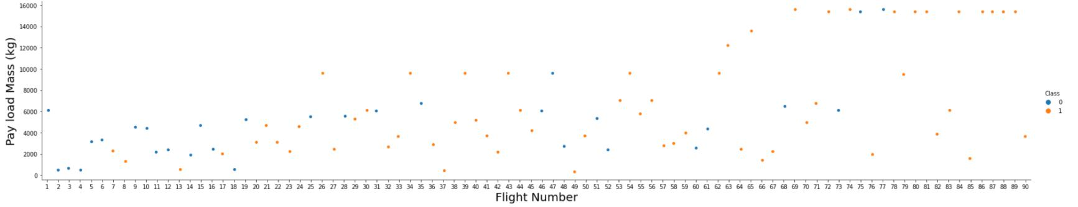
EDA with Data Visualization
To explore data, scatterplots and barplots were used to visualize the relationship between pair of features:
Payload Mass X Flight Number, Launch Site X Flight Number, Launch Site X Payload Mass, Orbit and Flight Number, Payload and Orbit
GitHub URL: http://localhost:8888/lab/tree/Desktop/IBM/Week%202%20-
%20EDA/5.EDA-with-Visaulization.ipynb
12

Slide 13
EDA with SQL
The following SQL queries were performed:
Names of the unique launch sites in the space mission;
Top 5 launch sites whose name begin with the string 'CCA’;
Total payload mass carried by boosters launched by NASA (CRS);
Average payload mass carried by booster version F9 v1.1;
Date when the first successful landing outcome in ground pad was achieved;
Names of the boosters which have success in drone ship and have payload mass between 4000 and 6000 kg;
Total number of successful and failure mission outcomes;
Names of the booster versions which have carried the maximum payload mass;
Failed landing outcomes in drone ship, their booster versions, and launch site names for in year 2015; and
Rank of the count of landing outcomes (such as Failure (drone ship) or Success (ground pad)) between the date 2010-06-04 and 2017-03-20.
GitHub URL: https://github.com/Moheid/IBM-SpaceY-DS-Capstone/blob/main/4.%20Complete-EDA-SQL.ipynb
13

Slide 14
Build an Interactive Map with Folium
Markers of all Launch Sites: - Added Marker with Circle, Popup Label and Text Label of NASA Johnson Space Center using its latitude and longitude coordinates as a start location. - Added Markers with Circle, Popup Label and Text Label of all Launch Sites using their latitude and longitude coordinates to show their geographical locations and proximity to Equator and coasts.
Coloured Markers of the launch outcomes for each Launch Site: - Added coloured Markers of success (Green) and failed (Red) launches using Marker Cluster to identify which launch sites have relatively high success rates.
Distances between a Launch Site to its proximities: - Added coloured Lines to show distances between the Launch Site KSC LC-39A (as an example) and its proximities like Railway, Highway, Coastline and Closest City
GitHub URL: https://github.com/Moheid/IBM-SpaceY-DS-Capstone/blob/main/5.EDA-with- Visaulization.ipynb

Slide 15
Build a Dashboard with Plotly Dash
Launch Sites Dropdown List: - Added a dropdown list to enable Launch Site selection.
Pie Chart showing Success Launches (All Sites/Certain Site): - Added a pie chart to show the total successful launches count for all sites and the Success vs. Failed counts for the site, if a specific Launch Site was selected.
Slider of Payload Mass Range: - Added a slider to select Payload range.
Scatter Chart of Payload Mass vs. Success Rate for the different Booster Versions: - Added a scatter chart to show the correlation between Payload and Launch Success
GitHub URL: https://github.com/Moheid/IBM-SpaceY-DS- Capstone/blob/main/7.spacex_dash.ipynb

Slide 16
Predictive Analysis (Classification)
To make predication we will follow the scientific procedure that we are going to build the modles
Refer to my GitHub URL notebook:
https://github.com/Moheid/IBM- SpaceY-DS- Capstone/blob/main/8.SpaceX_Mac hine%20Learning%20Prediction_Part
_5.ipynb
Creating a NumPy array from the column “Class” in data |  | Standardizing the data with StandardScaler, then fitting and transforming it |  | Splitting the data into training and testing sets with train_test_split function
Examining the confusion matrix for all models |  | Calculating the accuracy on the test data using the method .score() for all models |  | Creating a GridSearchCV object with cv = 10 to find the best parameters
Finding the method performs best by examining the Jaccard_score and F1_score metrics

Slide 17
Predictive Analysis (Classification)
Summarize how you built, evaluated, improved, and found the best performing classification model
You need present your model development process using key phrases and flowchart
Add the GitHub URL of your completed predictive analysis lab, as an external reference and peer-review purpose

Slide 18
Results
Exploratory data analysis results
Interactive analytics demo in screenshots
Predictive analysis results

Slide 19

Section 2

Slide 20
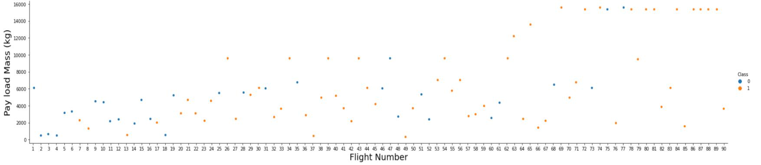
Flight Number vs. Launch Site
The earliest flights all failed while the latest flights all succeeded.
The CCAFS SLC 40 launch site has about a half of all launches.
VAFB SLC 4E and KSC LC 39A have higher success rates.
It can be assumed that each new launch has a higher rate of success.

Slide 21
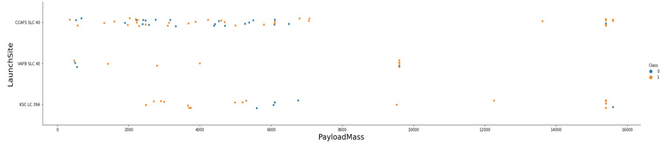
Payload vs. Launch Site
For every launch site the higher the payload mass, the higher the success rate.
Most of the launches with payload mass over 7000 kg were successful.
KSC LC 39A has a 100% success rate for payload mass under 5500 kg too.

Slide 22
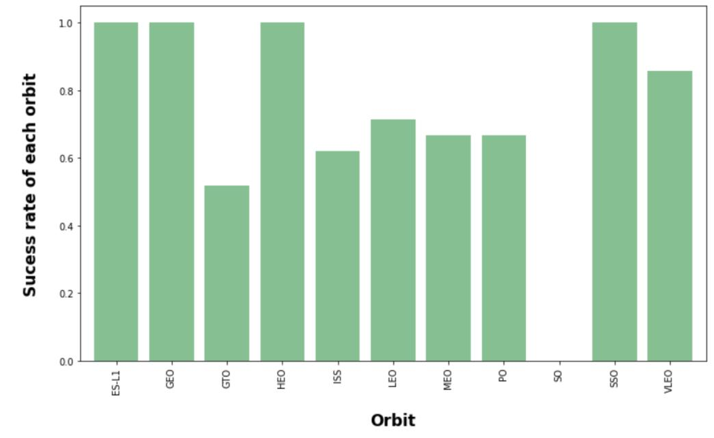
Success Rate vs. Orbit Type
Orbits with 100% success rate: - ES-L1, GEO, HEO, SSO
Orbits with 0% success rate:
- SO
Orbits with success rate between 50% and 85%: - GTO, ISS, LEO, MEO, PO

Slide 23
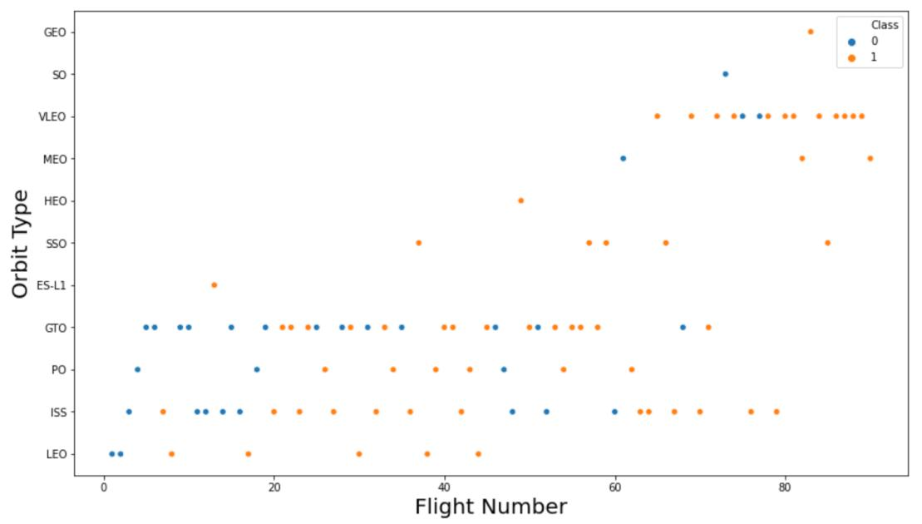
Flight Number vs. Orbit Type
In the LEO orbit the Success appears related to the number of flights; on the other hand, there seems to be no relationship between flight number when in GTO orbit

Slide 24
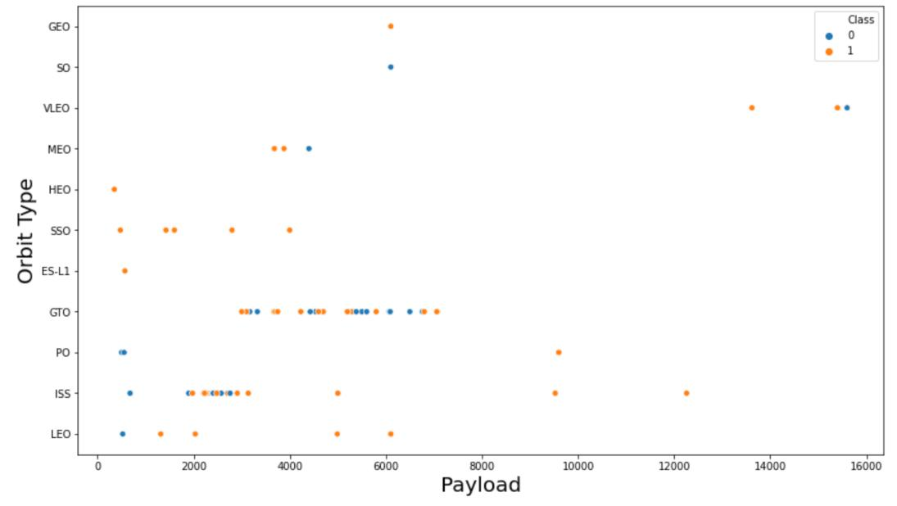
Payload vs. Orbit Type
With heavy payloads the
successful landing or
positive landing rate are
more for Polar, LEO and ISS.
However for GTO we
cannot distinguish this
well as both positive
landing rate and negative
landing(unsuccessful
mission) are both there here.

Slide 25
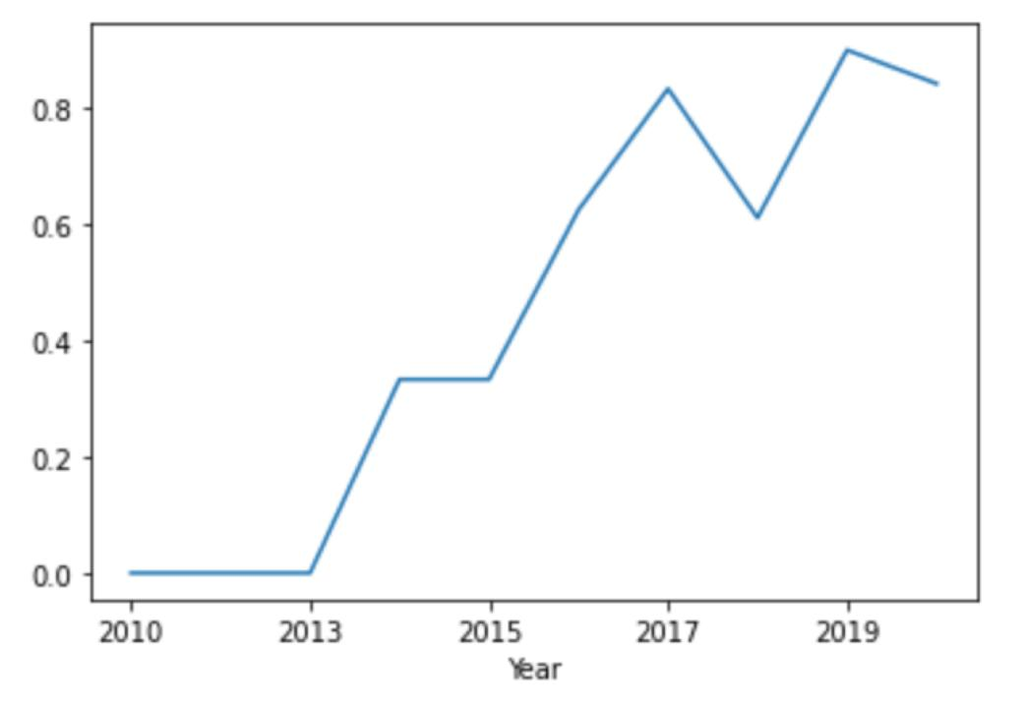
Launch Success Yearly Trend
you can observe that the success rate since 2013 kept increasing till 2020

Slide 26
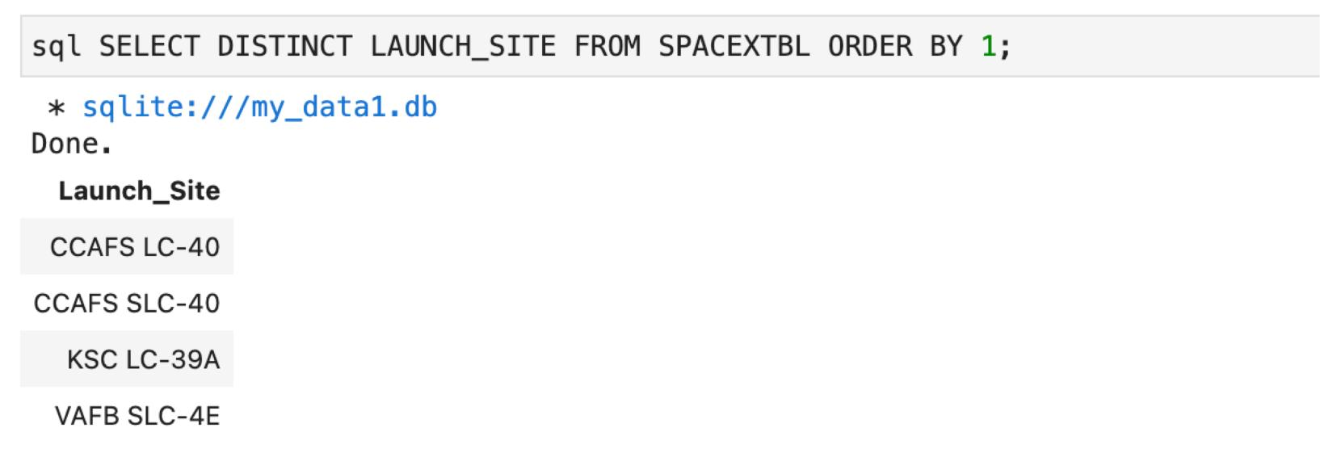
All Launch Site Names
Above coordinates are just plain numbers that can not give you any intuitive insights about where are those launch sites. If you are very good at geography, you can interpret those numbers directly in your mind. If not, that's fine too. Let's visualize those locations by pinning them on a map.

Slide 27
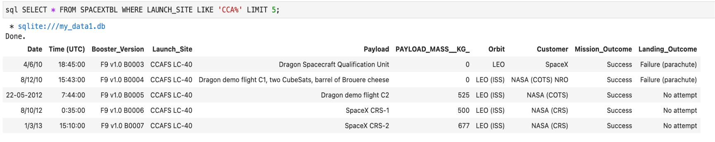
Launch Site Names Begin with 'CCA'
Displaying 5 records where launch sites begin with the string 'CCA'.

Slide 28
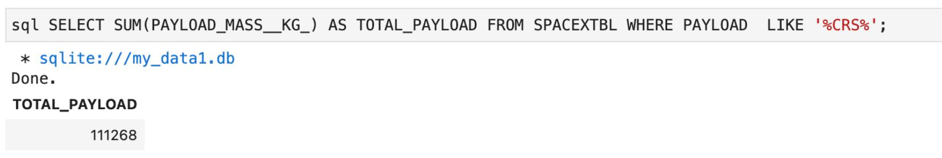
Total Payload Mass
Displaying the total payload mass carried by boosters launched by NASA (CRS).

Slide 29
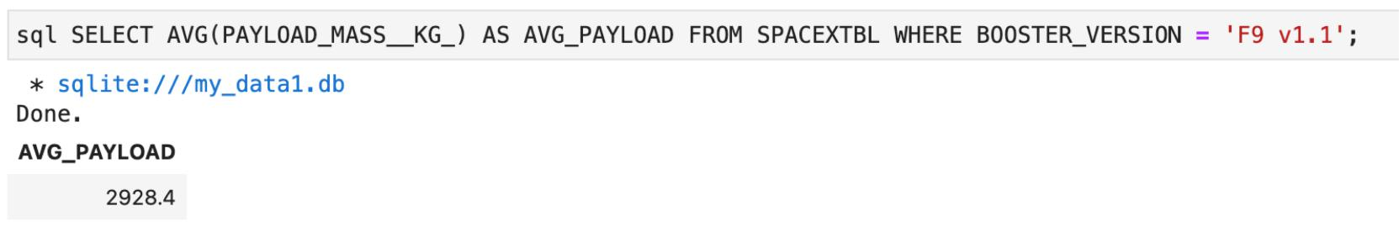
Average Payload Mass by F9 v1.1
Explanation:
Displaying average payload mass carried by booster version F9 v1.1.

Slide 30
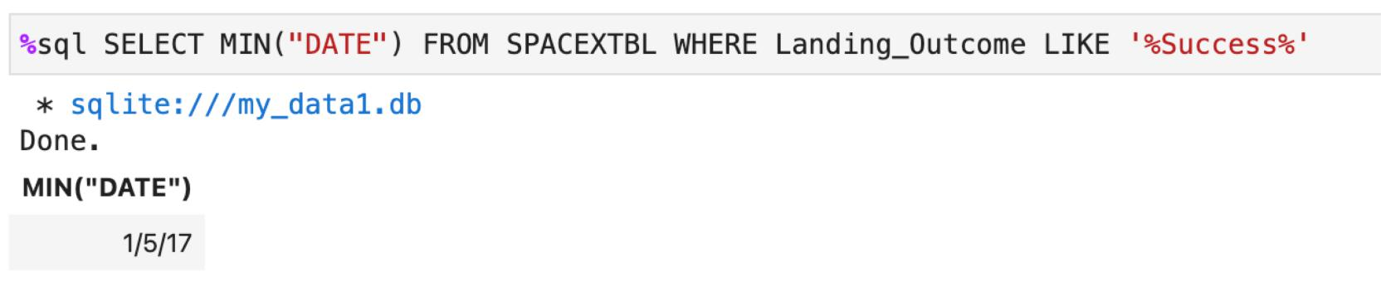
First Successful Ground Landing Date
Listing the date when the first successful landing outcome in ground pad was achieved

Slide 31
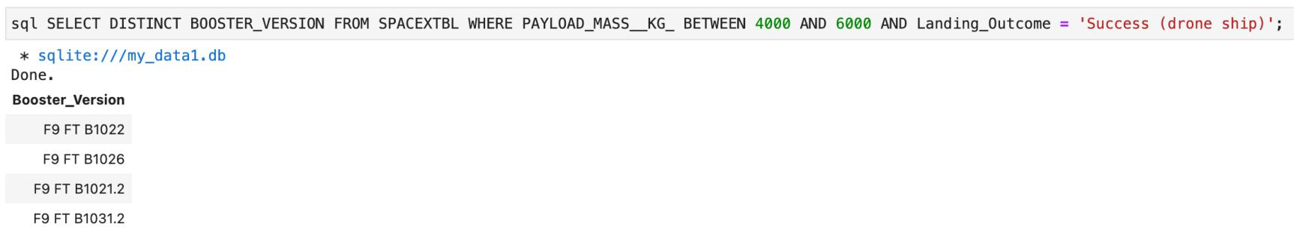
Successful Drone Ship Landing with Payload between 4000 and 6000
Listing the names of the boosters which have success in drone ship and have payload mass greater than 4000 but less than 6000.

Slide 32
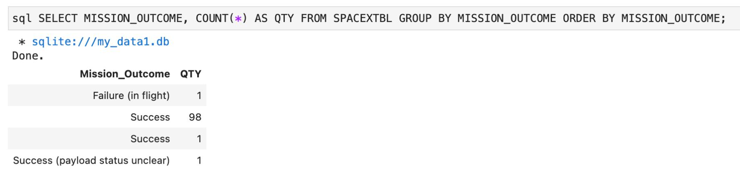
Total Number of Successful and Failure Mission Outcomes
Listing the total number of successful and failure mission outcomes.

Slide 33
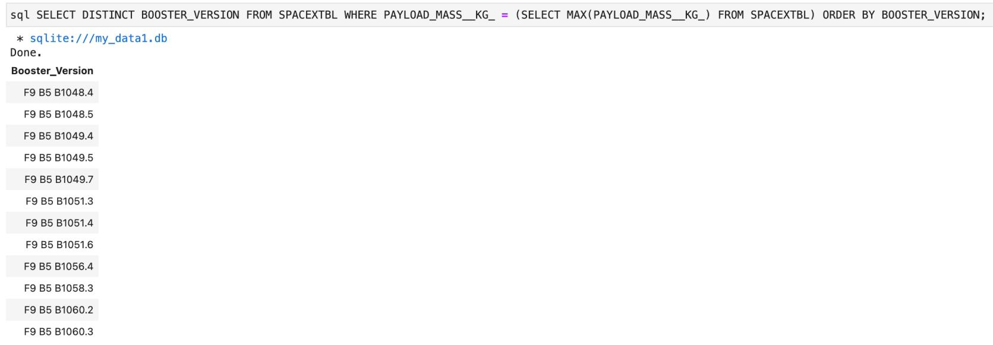
Boosters Carried Maximum Payload
Listing the names of the booster versions which have carried the maximum payload mass.

Slide 34
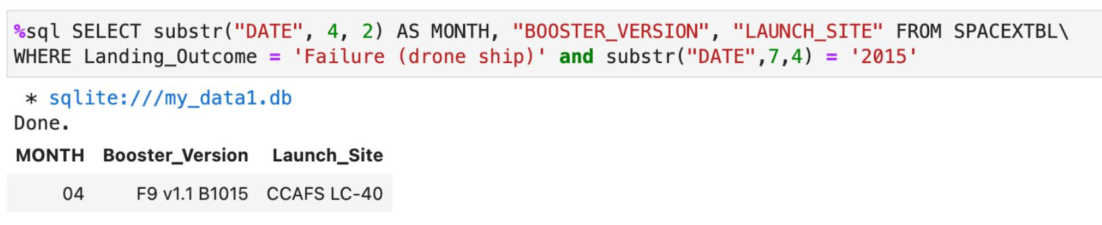
2015 Launch Records
Listing the failed landing outcomes in drone ship, their booster versions and launch site names for the months in year 2015.

Slide 35
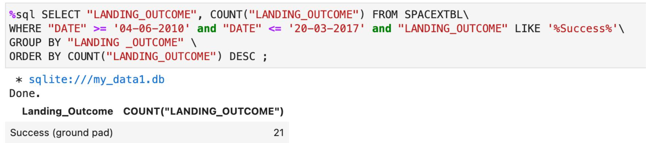
Rank Landing Outcomes Between 2010-06-04 and 2017-03-20
Ranking the count of landing outcomes (such as Failure (drone ship) or Success (ground pad)) between the date 2010-06-04 and 2017-03-20 in descending order.

Slide 36

Section 3

Slide 37
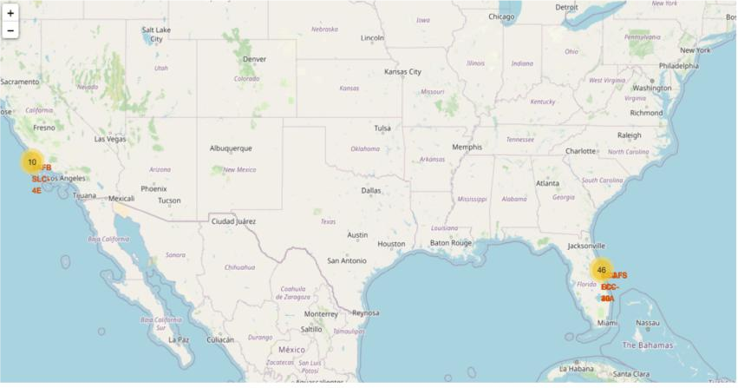
All Launch Sites’ Location Markers on a Global Map
Most of Launch sites are in proximity to the Equator line. The land is moving faster at the equator than any other place on the surface of the Earth. Anything on the surface of the Earth at the equator is already moving at 1670 km/hour. If a ship is launched from the equator it goes up into space, and it is also moving around the Earth at the same speed it was moving before launching. This is because of inertia. This speed will help the spacecraft keep up a good enough speed to stay in orbit.
All launch sites are in very close proximity to the coast, while launching rockets towards the ocean it minimises the risk of having any debris dropping or exploding near people.

Slide 38
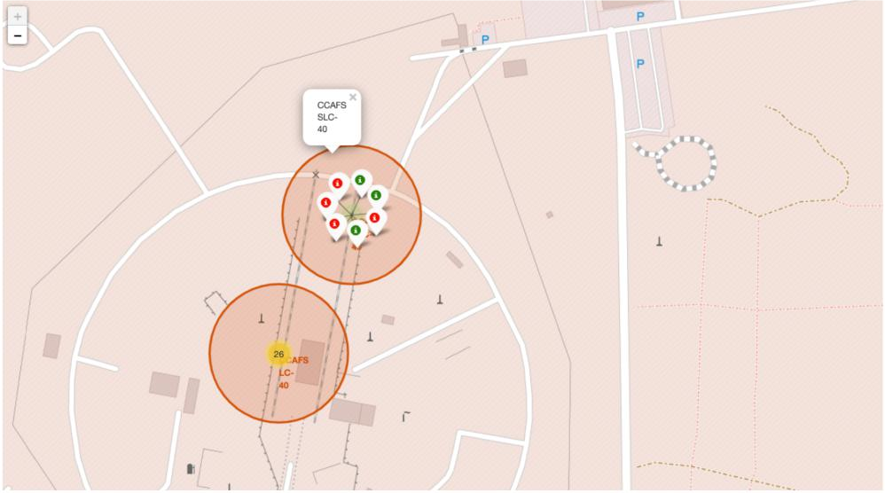
Colour-labeled launch records on the map
From the colour-labeled markers we should be able to easily identify which launch sites have relatively high success rates.
Green Marker = Successful Launch
Red Marker = Failed Launch
Launch Site KSC LC-39A has a very high Success Rate.

Slide 39
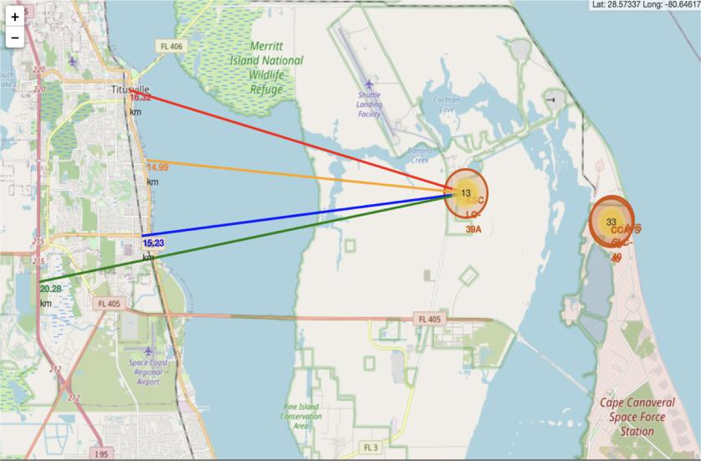
Distance from the launch site KSC LC-39A to its proximities
From the visual analysis of the launch site KSC LC-39A we can clearly see that it is: - relative close to railway (15.23 km) - relative close to highway (20.28 km) - relative close to coastline (14.99 km).
Also the launch site KSC LC-39A is relative close to its closest city Titusville (16.32 km).
Failed rocket with its high speed can cover distances like 15-20 km in few seconds. It could be potentially dangerous to populated areas.

Slide 40

Section 4

Slide 41
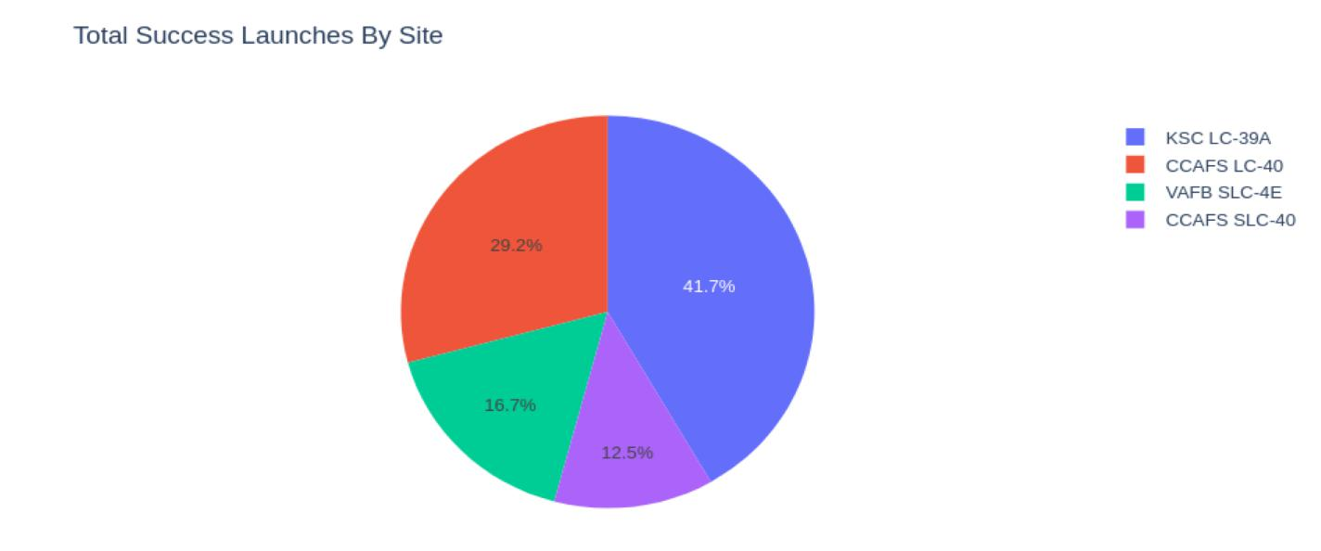
Launch success count for all sites
The chart clearly shows that from all the sites, KSC LC-39A has the most successful launches.

Slide 42
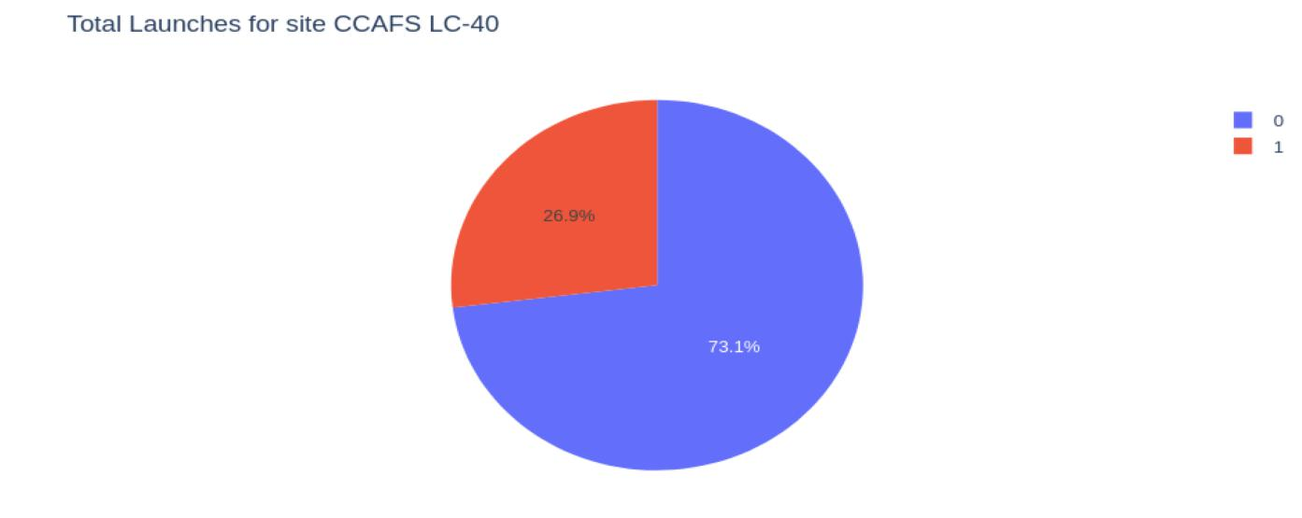
Launch site with highest launch success ratio
KSC LC-39A has the highest launch success rate (73.1%) with 10 successful and only 3 failed landings.

Slide 43
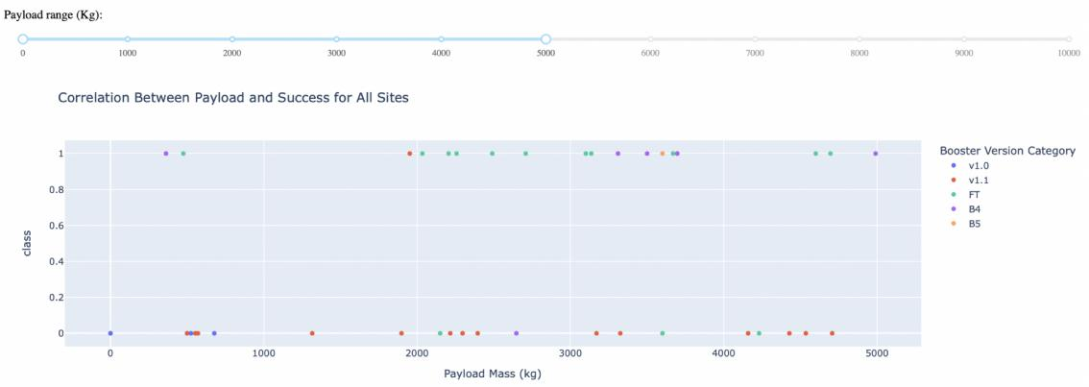
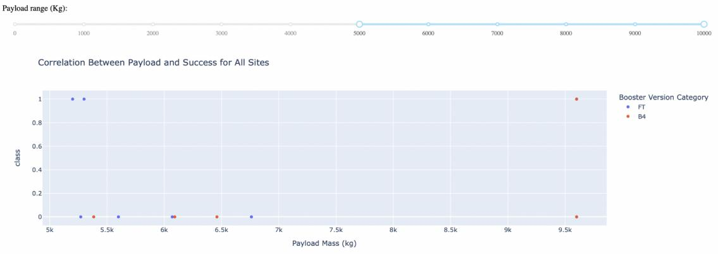
Payload Mass vs. Launch Outcome for all sites
The charts show that payloads between 2000 and 5500 kg have the highest success rate

Slide 44

Section 5

Slide 45
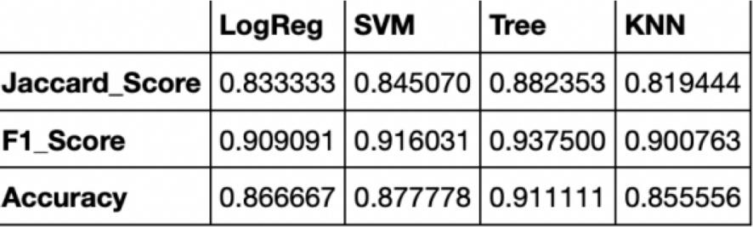
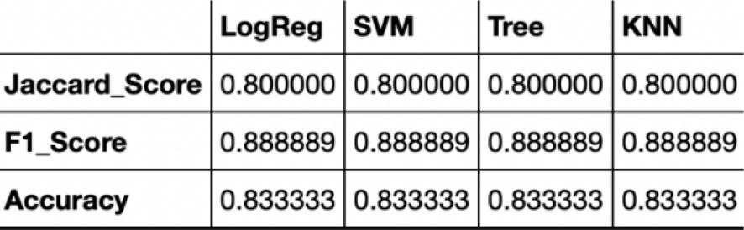
Classification Accuracy
Based on the scores of the Test Set, we can not confirm which method performs best.
Same Test Set scores may be due to the small test sample size (18 samples). Therefore, we tested all methods based on the whole Dataset.
The scores of the whole Dataset confirm that the best model is the Decision Tree Model. This model has not only higher scores, but also the highest accuracy.

Slide 46
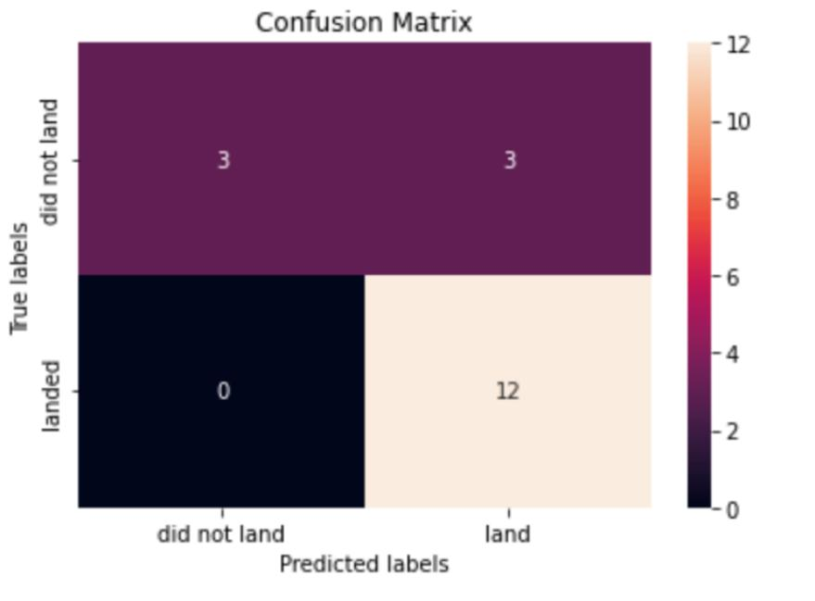
Confusion Matrix
Examining the confusion matrix, we see that logistic regression can distinguish between the different classes. We see that the major problem is false positives.

Slide 47
Conclusions
Decision Tree Model is the best algorithm for this dataset.
Launches with a low payload mass show better results than launches with a larger payload mass.
Most of launch sites are in proximity to the Equator line and all the sites are in very close proximity to the coast.
The success rate of launches increases over the years.
KSC LC-39A has the highest success rate of the launches from all the sites.
Orbits ES-L1, GEO, HEO and SSO have 100% success rate.

Slide 48
Appendix
Include any relevant assets like Python code snippets, SQL queries, charts, Notebook outputs, or data sets that you may have created during this project

Slide 49


